Slide 1

INDOOR AND OUTDOOR AIR POLLUTION
- By: EmbedElites
03/11/2023
TEAM 17
Team Members:
1. Archisha Panda
2. Paridhi Jain
3. Dharmineni Yashaswinee
4. Vyakhya Gupta

Slide 2

MOTIVATION
0311/2023
Objective: Develop an 'Air Quality Monitor' to improve air pollution awareness.
Parameters: Monitor PM 2.5, PM 10, Temperature, and Humidity levels.
Caution System: The dashboard transforms AQI colors, serving as a cautionary indicator of pollution levels.
Deployment: Install sensors indoors and outdoors
Data Collection: Continuous data collection uploaded to ThingSpeak.
Data Processing: Utilize machine learning for pollution analysis.
Benefits: Plan pollution mitigation strategies and assess indoor and outdoor air quality

Slide 3
FLOWCHART
03/11/2023
PM2.5
THINGSPEAK
DATABASE
DATA PREPROCESSING TO REMOVE OUTLIERS
PM10
ESP32
CALIBRATE SENSOR WITH STANDARD DATASET
AHT SENSOR
PROCESS DATA COLLECTED FOR ANALYSIS

Slide 4
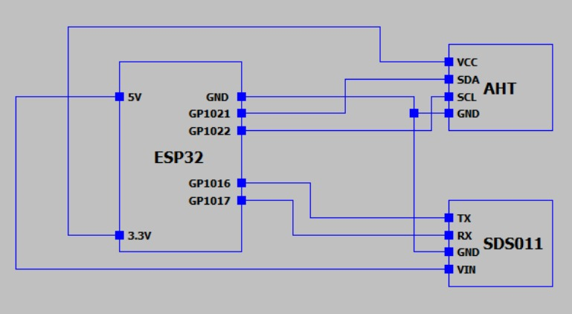
CIRCUIT DIAGRAM
03/11/2023

Slide 5
20/11/2023
TIMELINE
LAB1
Develop a comprehensive project plan that includes tasks, milestones, and dependencies.
LAB2
Acquire SDS011 and AHT sensors along with necessary components. Verified and understood the working of SDS011 and AHT sensor.
LAB8
Dashboard with basic amenities is created. Historical data, Real time data, Prediction of data can be accessed
LAB3
Hardware Integration: Assemble the sensors and interface them with a microcontroller (esp32). Started working on the zero PCB to build a deployable model
LAB7
PM 2.5 and PM 10 have been calibrated with reference to Aero PM standard dataset.
LAB6
Complete model has been built and deployed in the lab for 2 weeks data
Sent almost 5000 entries to Thingspeak over this period
LAB4
Data collection (>=2000 data points over 2 days) and sent to Thingspeak
LAB5
Fetching data from ThingSpeak and pre-processing the data

Slide 6
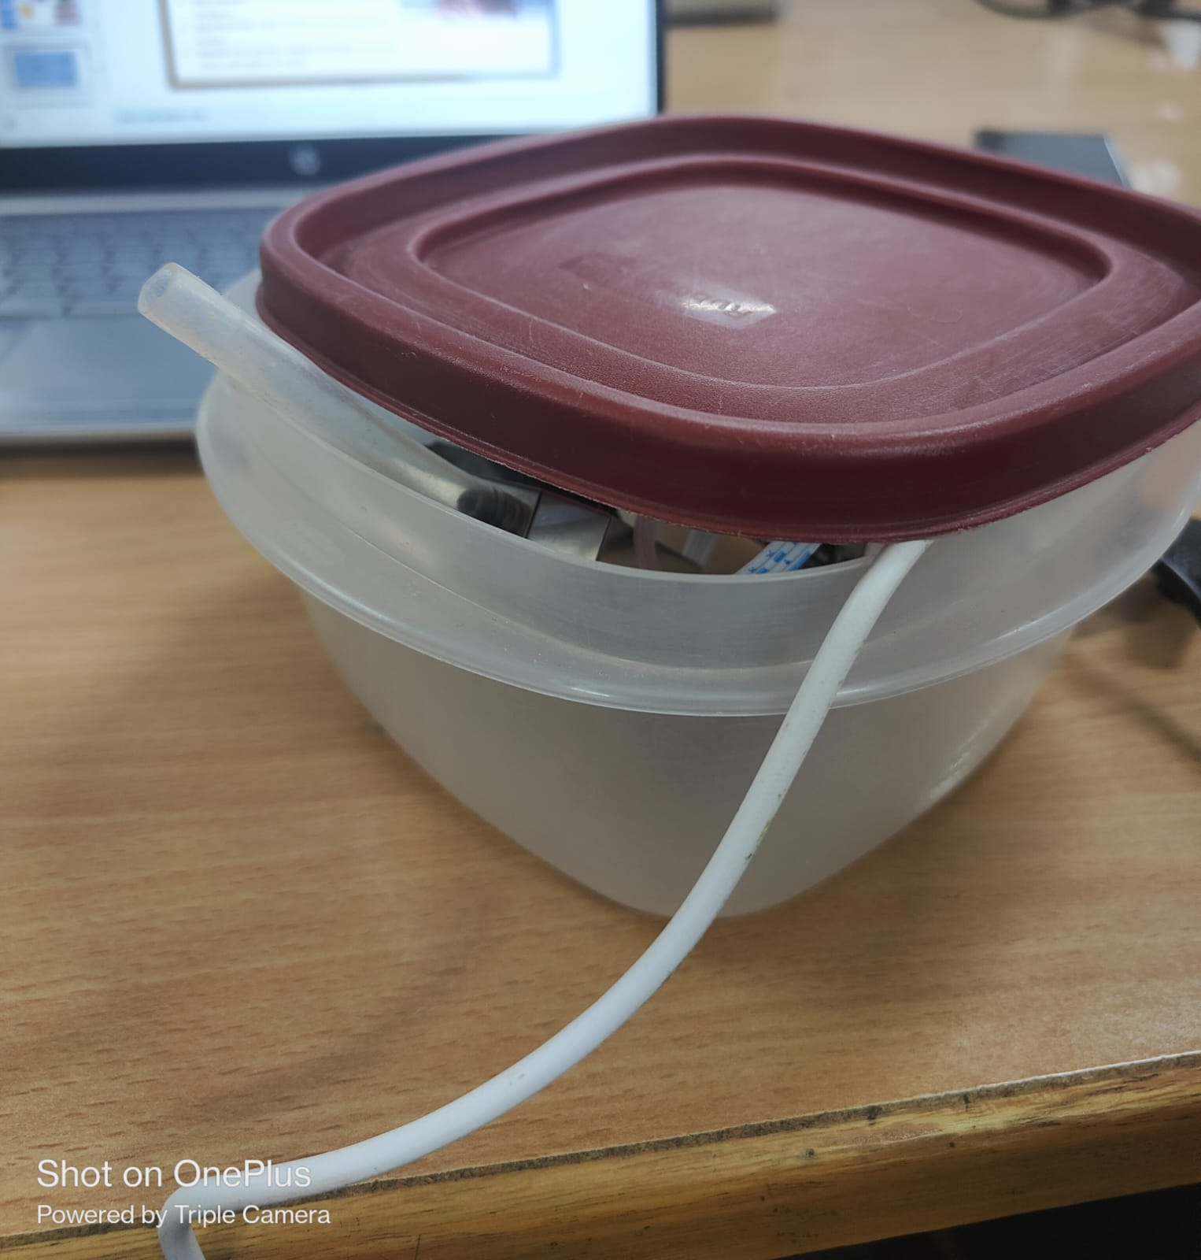
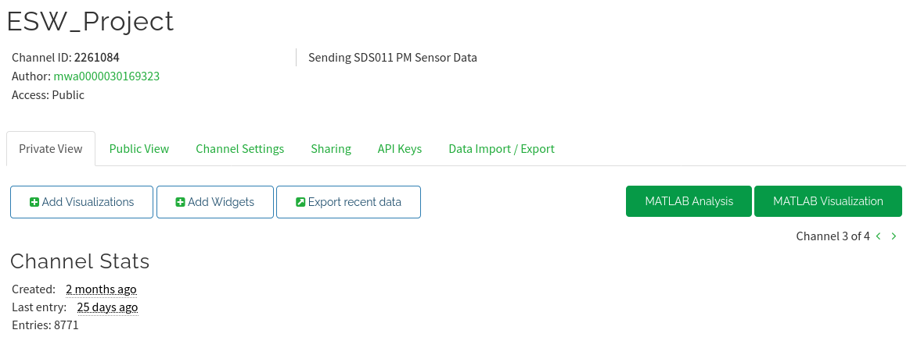
DEPLOYMENT
20/11/2023
The PCB constructed was deployed in NBH and our room with data entries collected and pushed to Thingspeak.

Slide 7
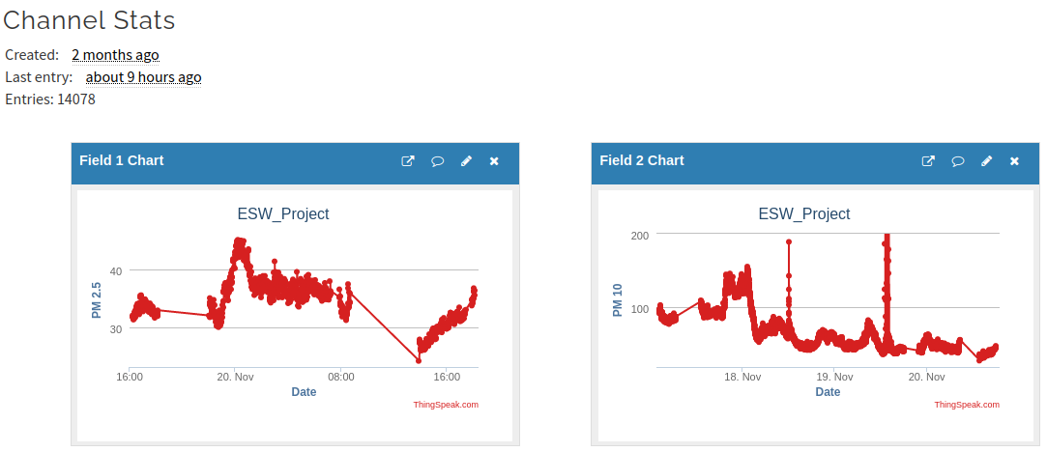
THINGSPEAK-CHANNEL 1 (INDOOR)
20/11/2023

Slide 8
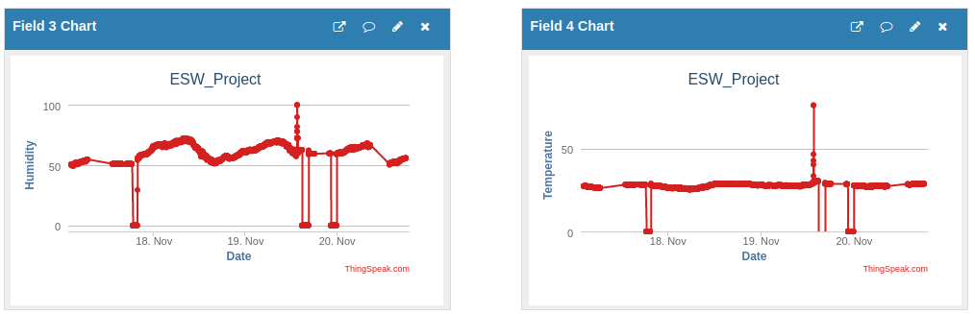
THINGSPEAK-CHANNEL 1 (INDOOR)
20/11/2023

Slide 9
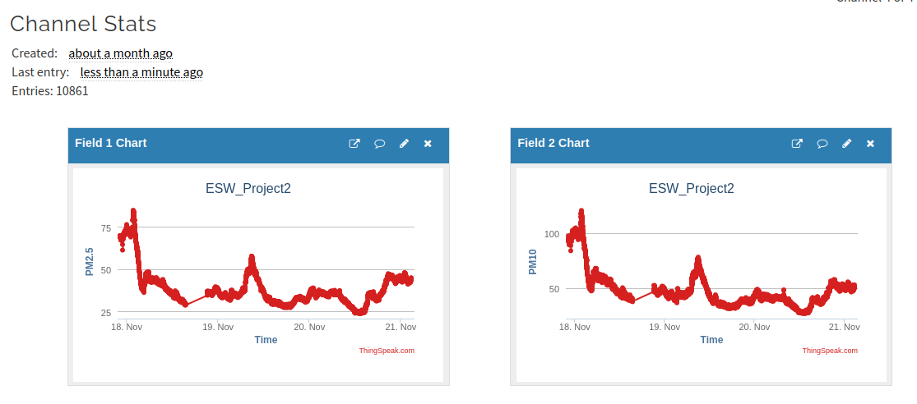
THINGSPEAK - CHANNEL 2 (OUTDOOR)
20/11/2023

Slide 10
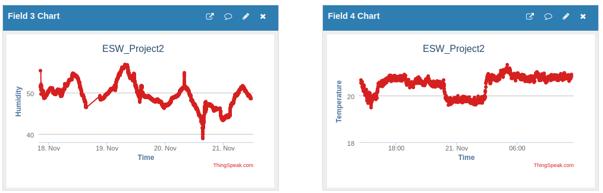
THINGSPEAK - CHANNEL 2 (OUTDOOR)
20/11/2023

Slide 11
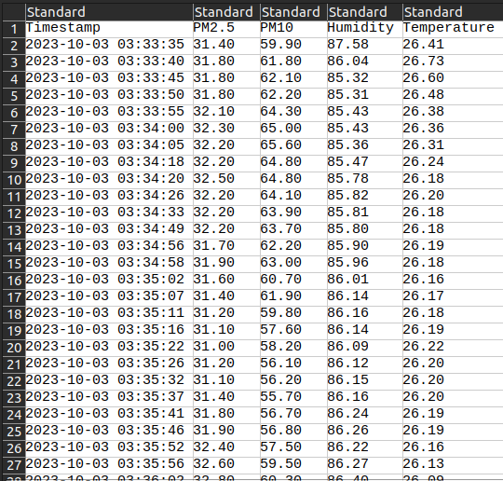
UPDATING DATABASE
07/11/2023
The data is then fetched from ThingSpeak for pre-processing.

Slide 12
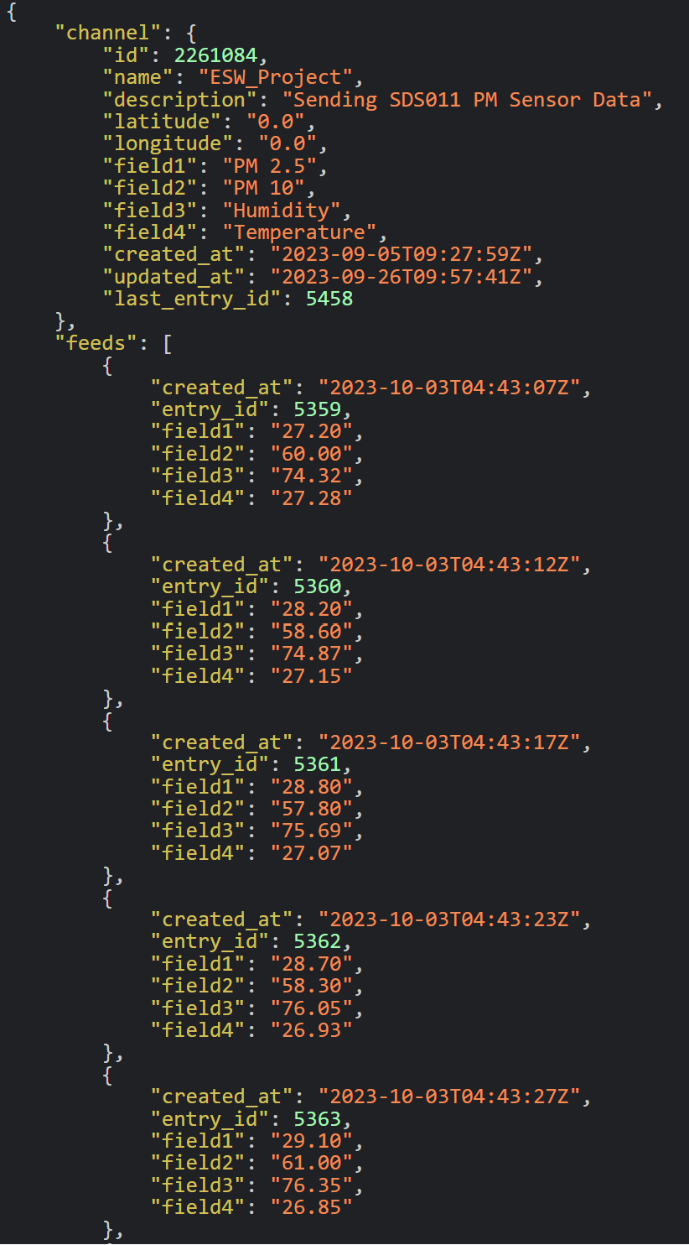
DATA PREPROCESSING
07/11/2023
Extract the relevant data from the JSON response using Read API key from ThingSpeak.
Remove duplicates according to timestamps.
Remove Outliers (eg. removing entries with RH>=90).
Interpolate to fill missing values.
Remove irrelevant data using interquartile range.
Retime to reduce the volume of dataset.
Maintain moving average for data consistency.
Raw data is preprocessed and ready for analysis.
DATA STORED IN THINGSPEAK

Slide 13
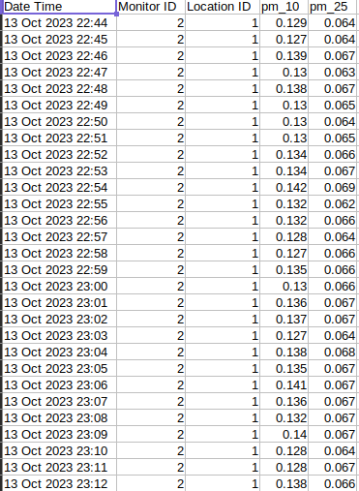
CALIBRATION OF SENSORS
07/11/2023
We were provided with a standard dataset collected from Aero PM sensor.
Data from our database was pre-processed to remove any outliers and ensure consistency in data points.
The pre-processed data and standard dataset was then used for calibration of sensor.
AERO PM DATA

Slide 14
CALIBRATION OF SENSORS
07/11/2023
The data points are aligned according to timestamps.
Plot local data versus standard dataset and obtain a linear relation between them (y=mx+c where y: standard dataset , x: local data, m:scaling factor and c: offset)

Slide 15
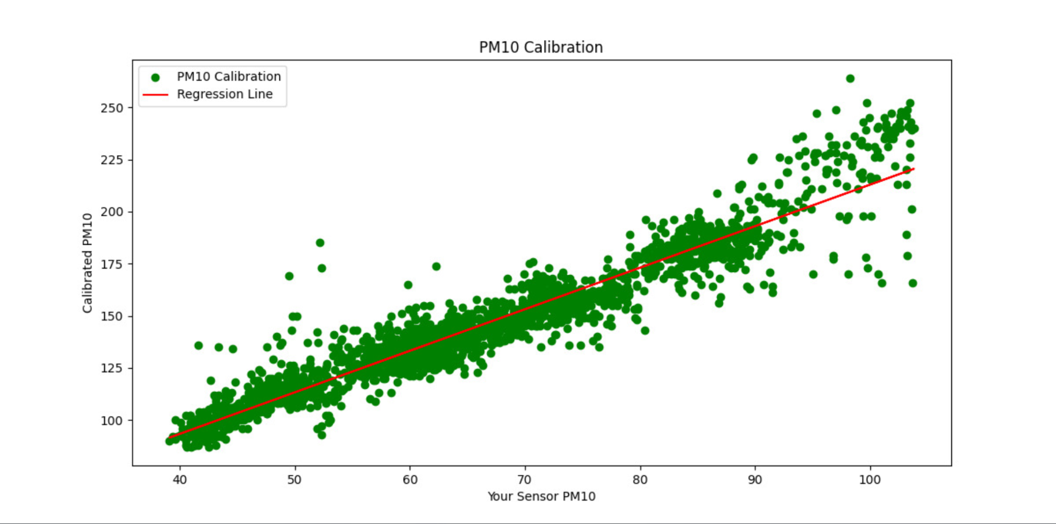
CALIBRATION OF SENSORS
07/11/2023
Result:
Scaling Factor (PM10): 1.9935275505072367 Offset (PM10): 13.568800635884315 RMSE (PM10): 9.665478354202433

Slide 16
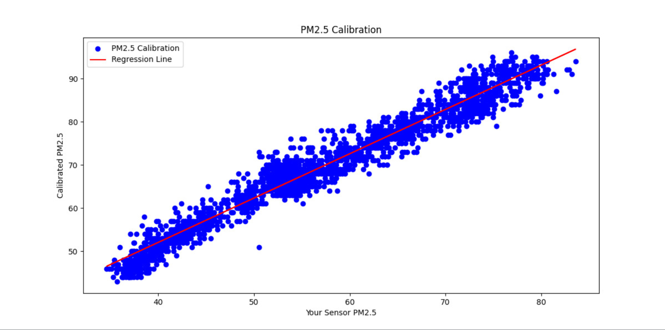
CALIBRATION OF SENSORS
07/11/2023
Result:
Scaling Factor (PM2.5): 1.0256618336813879 Offset (PM2.5): 11.048211689089669
RMSE (PM2.5): 2.7046325971438927

Slide 17
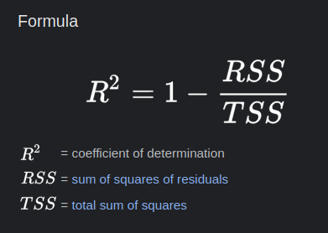
CALIBRATION OF SENSORS
07/11/2023
Now we can plug our collected data points into this equation to obtain legitimate data for analysis.
Coefficient of Determination:
R-squared (PM10): 0.9098807762004294
R-squared (PM2.5): 0.9547599726165852
An R-squared value above 0.7 is generally considered a strong fit. It suggests that the calibration explains a large proportion of the variance in the data, and it is providing useful information for prediction or analysis.
Our R-squared obtained using linear regression for SDS011 sensor ~ 0.9 > 0.7. Hence, the sensor is now calibrated to give correct readings.

Slide 18
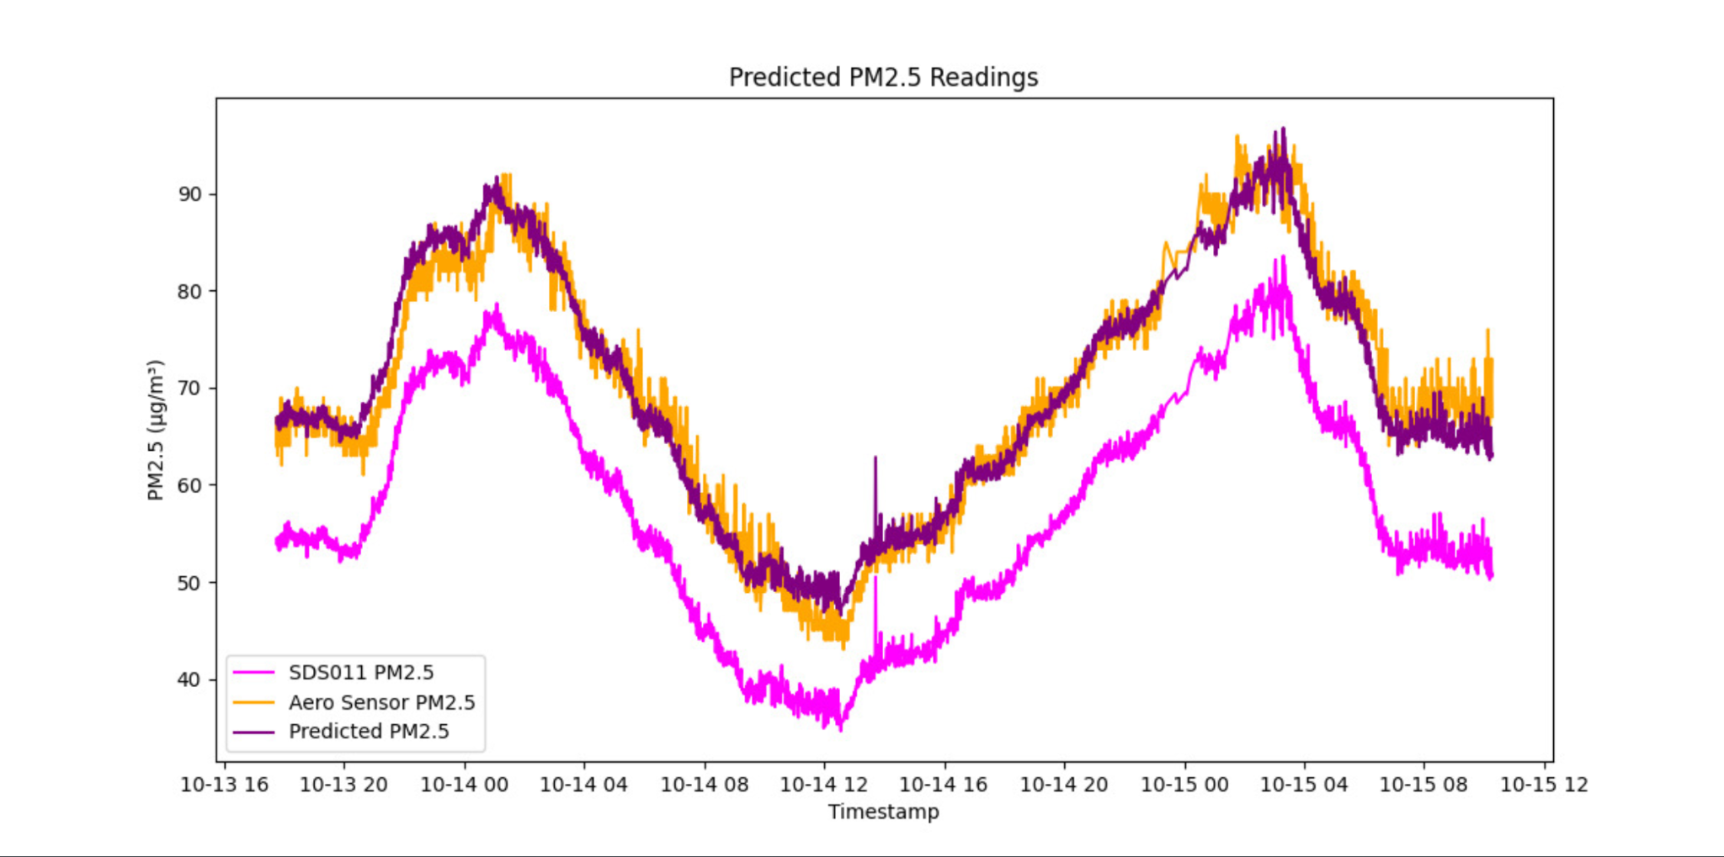
CALIBRATION OF SENSORS
07/11/2023

Slide 19
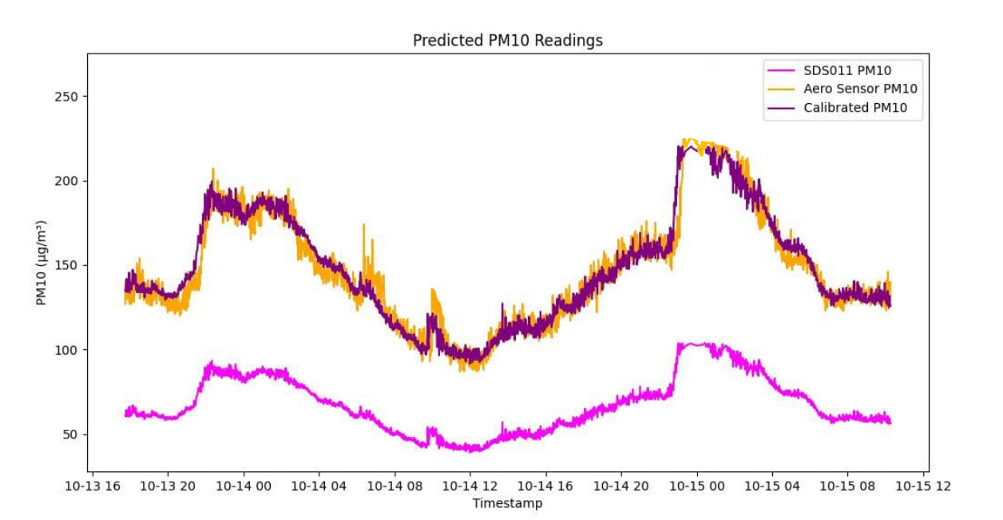
CALIBRATION OF SENSORS
07/11/2023

Slide 20
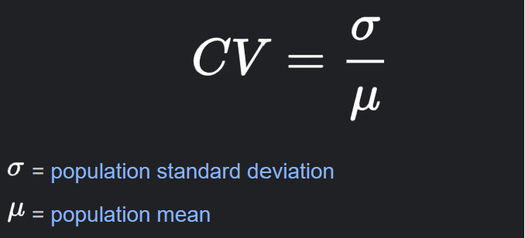
COEFFICIENT OF VARIABILITY OF DATA (INDOOR)
07/11/2023
Coefficient of variation is a relative measure of dispersion that is used to determine the variability of data.
Coefficient of Variation (CV) for PM2.5 data: 23.95%
Coefficient of Variation (CV) for PM10 data: 24.78%
Coefficient of Variation (CV) for Humidity data: 11.78%
Coefficient of Variation (CV) for Temperature data: 12.67%

Slide 21
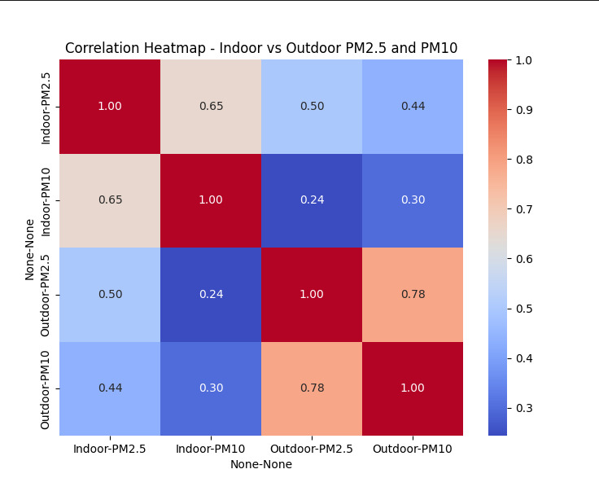
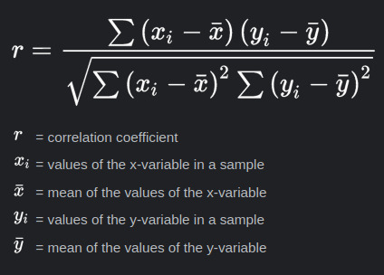
CORRELATION BETWEEN INDOOR AND
OUTDOOR PM
07/11/2023

Slide 22
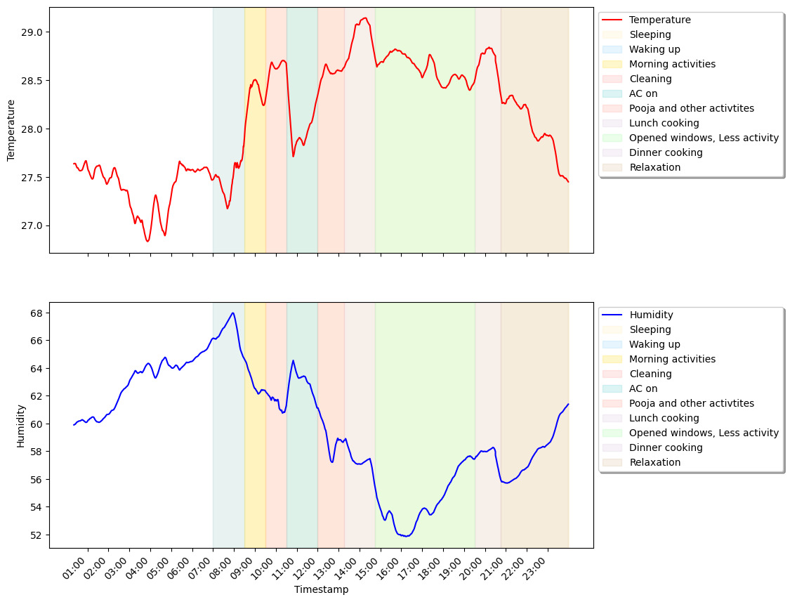
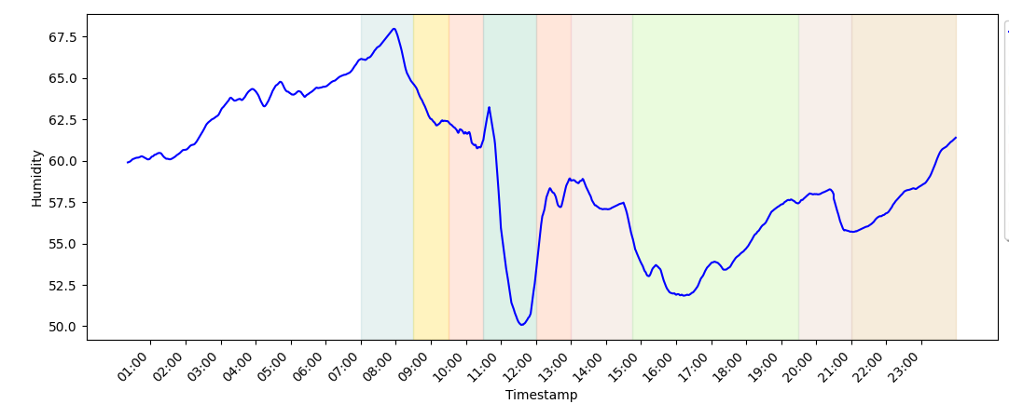
ANALYSIS
20/11/2023
Analyzing the graph from this slide reveals fluctuations in temperature and humidity during different activities in an Indian household:
Morning wake up shows a temperature drop and humidity rise.
Daytime and cleaning exhibit rising temperature and declining humidity.
Pooja and cooking result in a temperature hike with minimal humidity change.
Opening windows leads to decreased humidity and maintained temperature.
Nighttime sees a temperature decrease and a slight humidity rise.

Slide 23
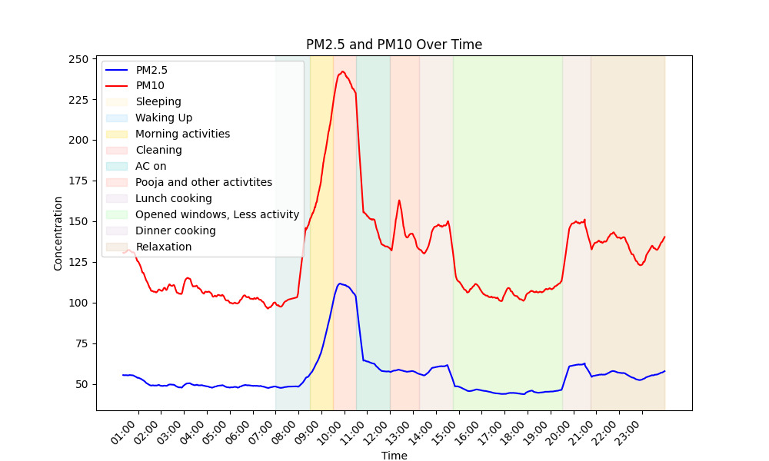
ANALYSIS
20/11/2023
Analyzing the PM10 and PM2.5 graph indicates minimal pollution during sleep.
Upon waking and engaging in morning activities and cleaning, pollution levels gradually rise, spiking notably during cleaning due to dust particles.
AC usage maintains low PM10 and PM2.5 readings.
During puja and cooking, a slight increase in PM10, with a similar trend during dinner cooking.
Levels decrease during less activity and moderately increase during relaxation at night.

Slide 24
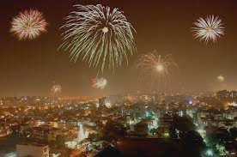
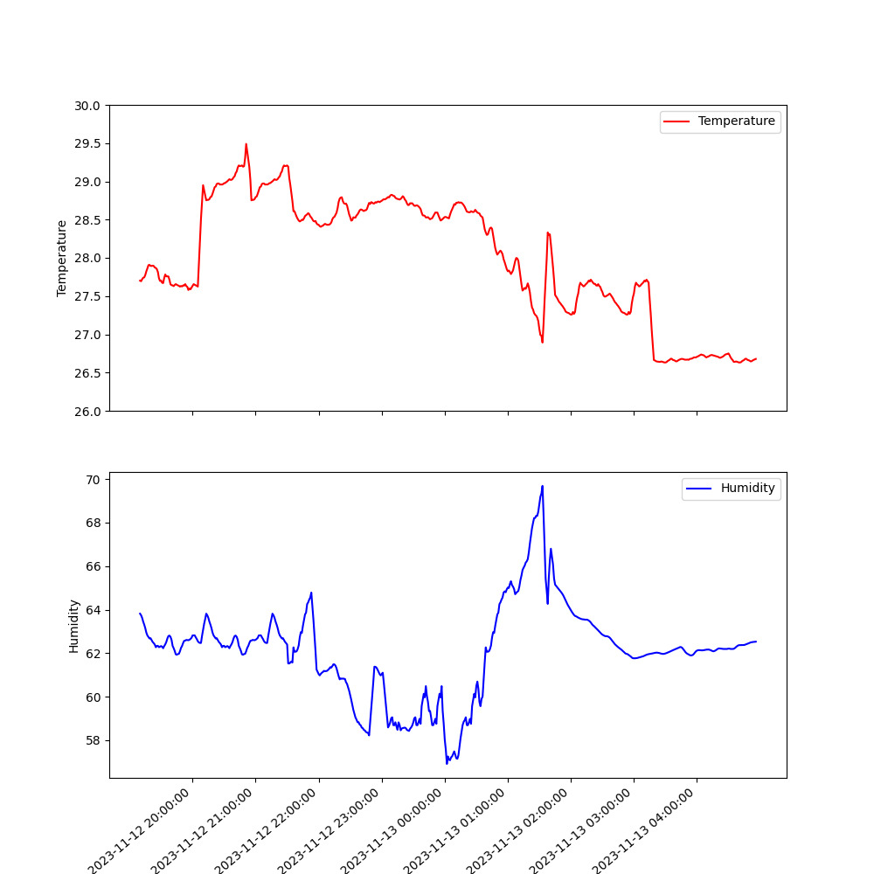
OBSERVATIONS
20/11/2023
Diwali
During Diwali, due to the bursting of crackers, there was a noticeable surge in pollution levels.
This increase in pollution levels was evident in the higher concentrations of particulate matter, with PM2.5 registering at 231.57 and PM10 at 579.73.
The festive activities contributed to a rise in humidity, recorded at 66.43%, and a temperature increase to 27.99°C

Slide 25
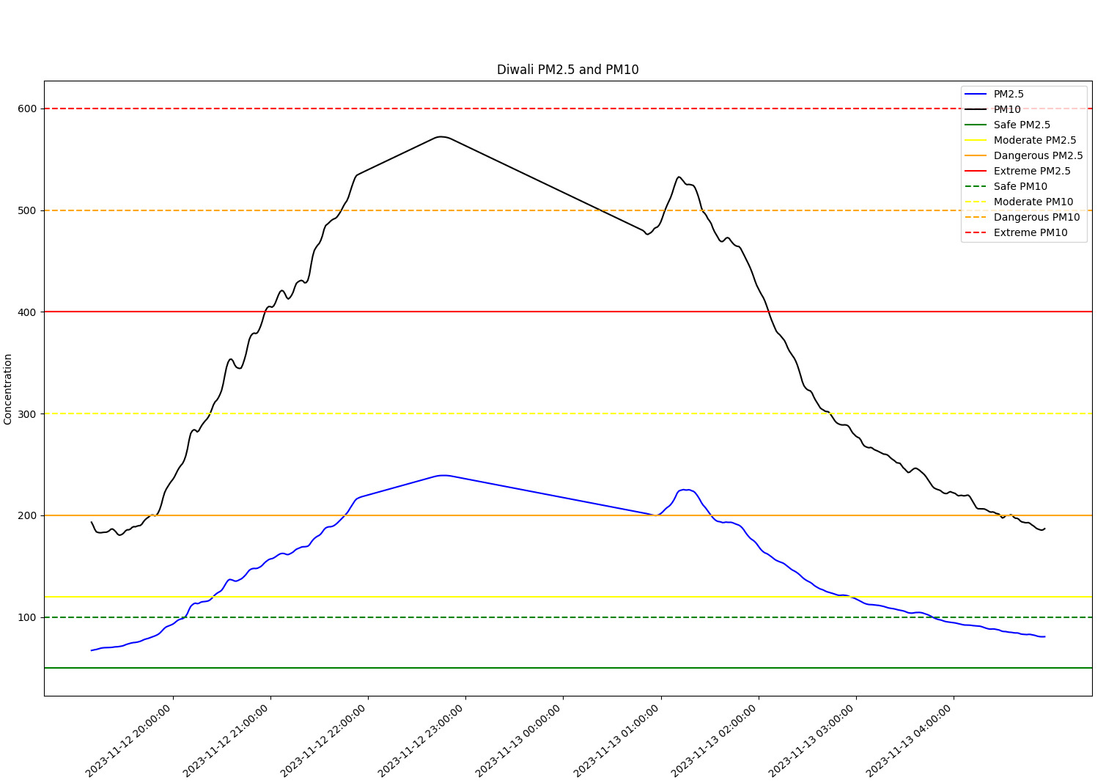
OBSERVATIONS
20/11/2023

Slide 26
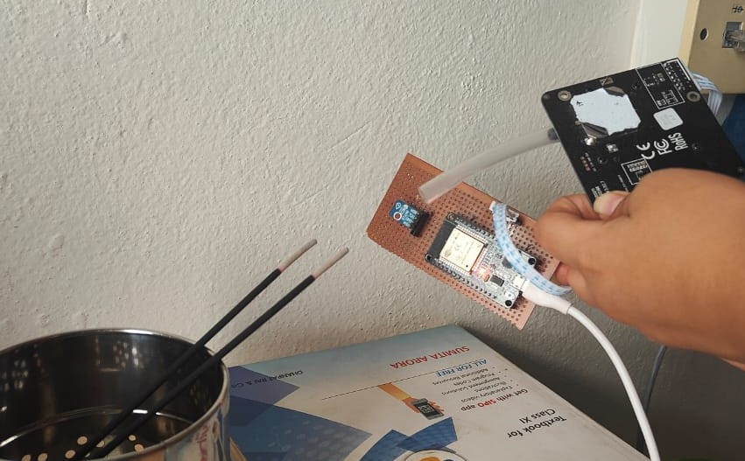
OBSERVATIONS
20/11/2023
Cleaning
While cleaning, we noticed a rise in PM2.5 and PM10
levels. This increase is likely due to the disturbance of settled dust, use of cleaning agents, and mechanical actions involved in the cleaning process.
Boiling
Boiling activities result in a simultaneous elevation of temperature and humidity levels, noticeable during the process.
Incense Stick
The burning of incense sticks contributes to an escalation in PM2.5 and PM10 levels, influencing air quality during their combustion.

Slide 27

DASHBOARD
20/11/2023

Slide 28
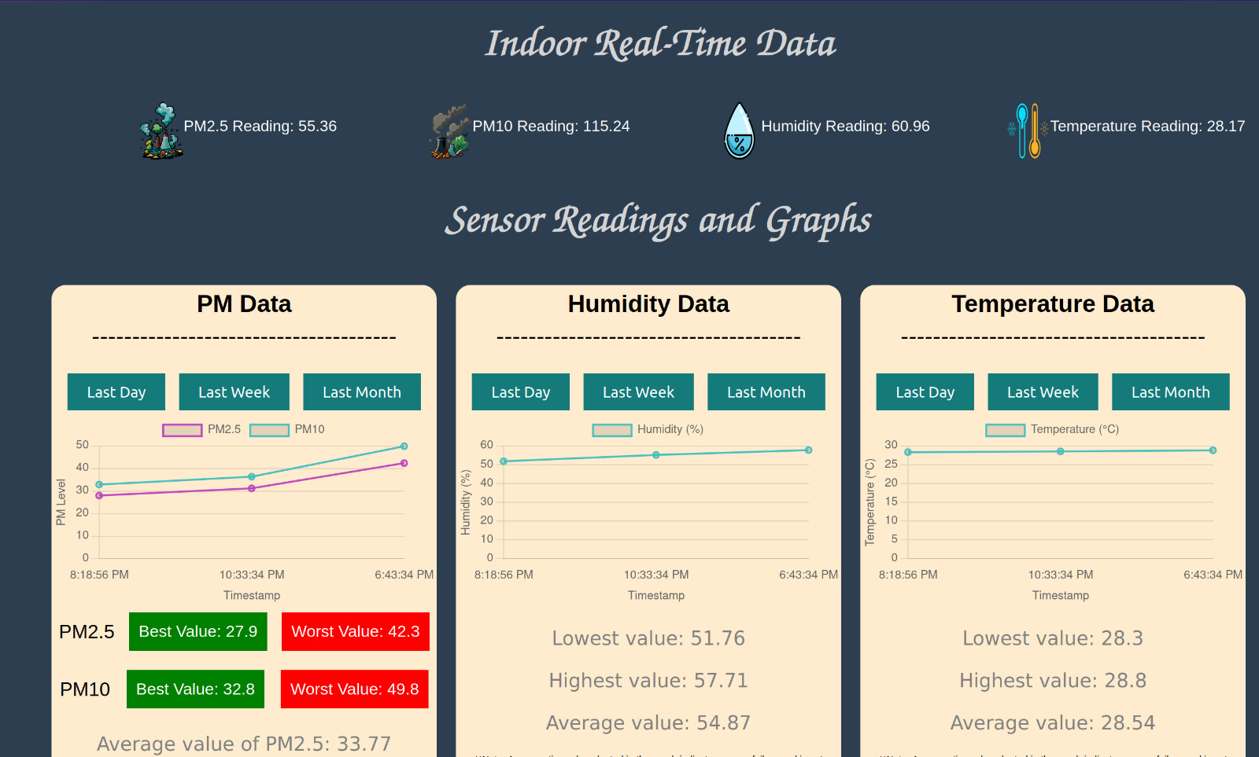
DASHBOARD
20/11/2023

Slide 29
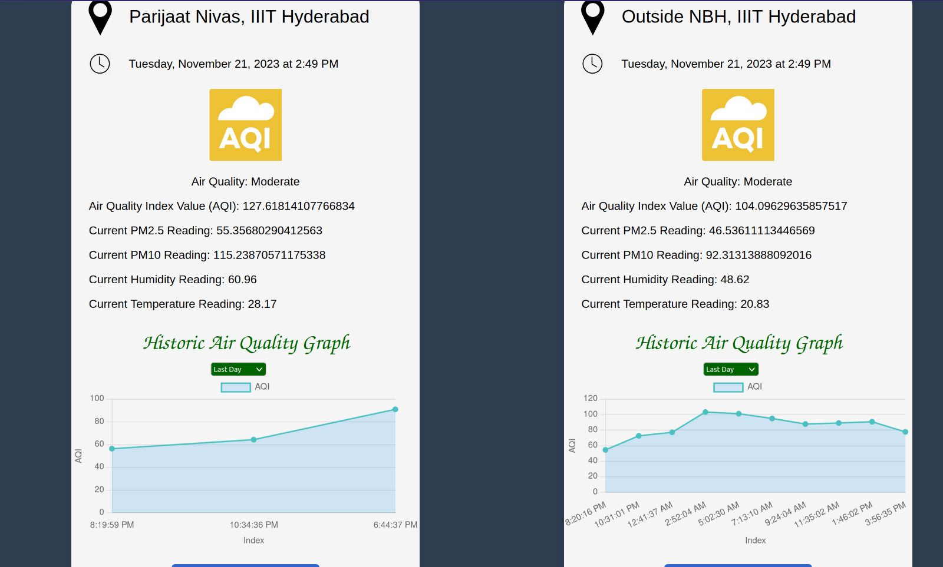
DASHBOARD
20/11/2023

Slide 30
DASHBOARD
20/11/2023
The dashboard will show:
HOME:
Navigates to other components of dashboard
Description of our project
Shows air quality of indoors and outdoors
Current readings of all sensors for indoors and outdoors
REALTIME: PM 2.5, PM 10, Temperature, Humidity data of real time is collected from sensors, published to thingspeak and exhibited here
HISTORICAL ANALYSIS: Data retrieved from thingspeak of last day, last week, last month is shown here.

Slide 31
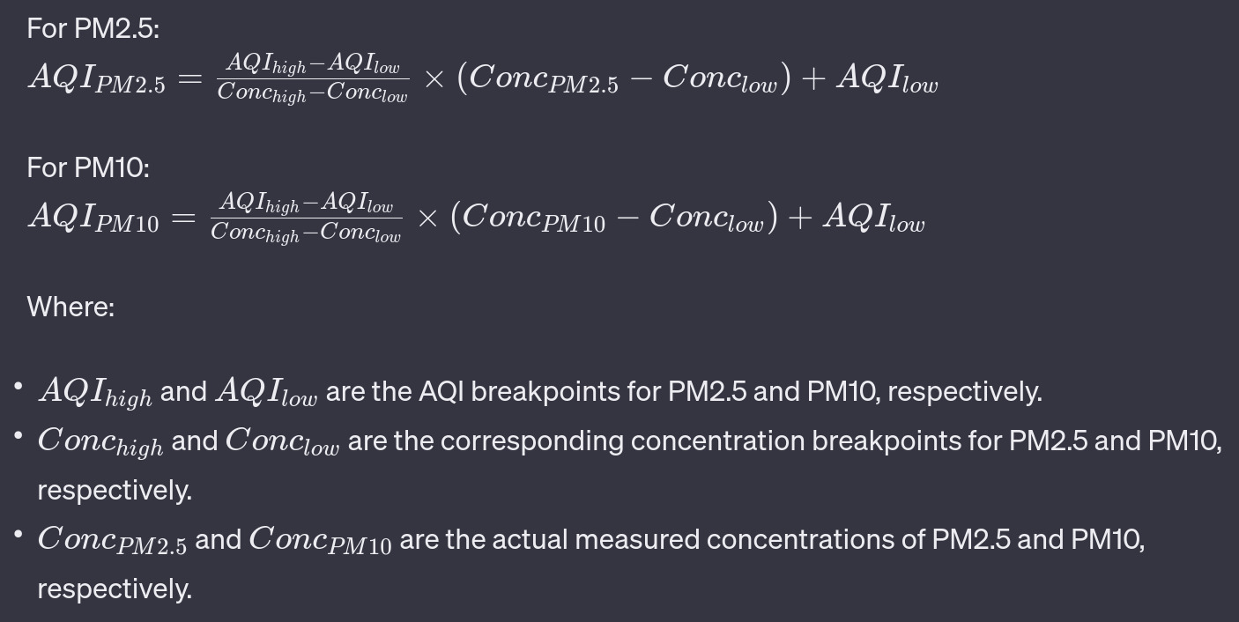
CALCULATION OF AIR QUALITY INDEX (AQI)
20/11/2023

Slide 32
CONCLUSION
20/11/2023
Data collection done by us during Diwali highlighted the significant rise in pollution levels. This could be captured even by sensors deployed inside our room which is alarming. The PM2.5 and PM10 values shooted to 231.57 and 579.73 respectively which is highly unsafe according to health standards.
For indoor pollution, we performed several activities like cooking, dusting, etc over the span of a day to simulate an average Indian household. The data collected showed variations in PM2.5 and PM10 and other parameters associated with these activities indicating extent to which even indoor pollution can impact our health.
Combining the results of indoor and outdoor data collection, we concluded that the correlation factor of a room not very well ventilated to outdoors is less than the correlation factor a well-ventilated room would achieve.

Slide 33
CHALLENGES FACED
20/11/2023
Outdoor sensor deployment on Friday limited data points for initial analysis.
Frequent disconnection due to power shortages and network issues results in missing data.

Slide 34


